Slide 1
Classifying Plankton
Alex Nguyen

Slide 2

Background info
The dataset comes from a Kaggle competition hosted by the National Data Science Bowl.
Plankton are critically important to the ocean ecosystem. Thus there is a need for researchers to monitor plankton populations.
Manual methods of classifying plankton are extremely infeasible, so automated methods via machine learning are practically required.

Slide 3
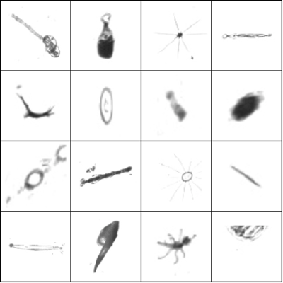



Dataset
The dataset consists of 30k labeled training images.
121 different classes of plankton to classify
Image dimensions ranged from 40 pixels to 400 pixels wide
Split into 25k for training, and 5k for validation
Acantharia protist
Stomatopod
Heteropod

Slide 4

Initial ConvNet Model
Model 1: 2C → 2FC
Input: 6400
⇩
6 Conv K=5,S=1,P=0
⇩
Max Pool K=2,S=2
⇩
6 Conv K=5,S=1,P=0
⇩
Max Pool K=2,S=2
⇩
FC 400
⇩
FC 200
⇩
Output: 121
Adapted from the Pytorch tutorial as an initial baseline
Resize to 80 by 80 images
RELU activations and using SGD optimizer with
LR = 0.00, Momentum = 0.9
Normalize to have mean ~0 and variance ~1

Slide 5

Evaluation Metrics
$Accuracy=\frac{1}{n}\sum_{i=1}^{n}{𝟙(y_{i}={\hat{y}}_{i})}$
$L_{Cross Entropy}=\frac{1}{n}\sum_{i=1}^{n}{\sum_{j=1}^{m}{y_{ij}log(g_{ij})}}$
While the two are highly correlated, accuracy refers to the rate of correct classification while cross entropy takes into the account of the uncertainty or confidence of each class prediction per output

Slide 6

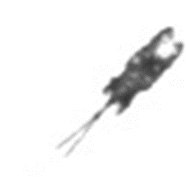
Data Augmentation
Vertical Flip
Translation
We want to train the neural net to be invariant these flips and rotations, since all 3 of the pictures represent the same thing. The transformation should not affect the classification.
Helps control for overfitting by artificially increasing the training set, so it doesn’t see the exact same pictures every epoch, so helps to generalize the model better.
Before a batch goes into the model for training, it is randomly transformed.

Slide 7
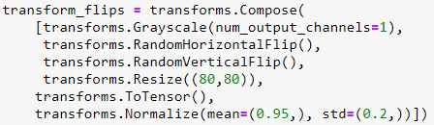
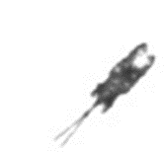
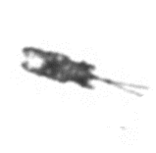
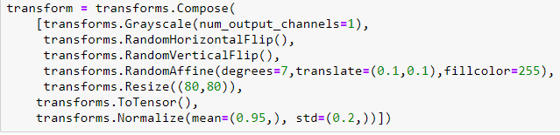
Data Augmentation
No Transforms
Flips only
Flips, rotation, and translation

Slide 8
Results

Slide 9
Data Augmentation
Without data augmentation, model starts to generalize poorly and severely overfit
Adding more transformations takes the model longer to converge, but the tradeoff is better generalization
In the initial epochs, unaugmented data into model shows better metrics but only up to a point

Slide 10
Batch Sizes
Tested baseline model on batch sizes of 16, 32, 48, and 64
Batch size of 16 gave the best validation loss
Literature also supports the notion of smaller batch sizes leading to better generalization power by Keskar, N et al.

Slide 11
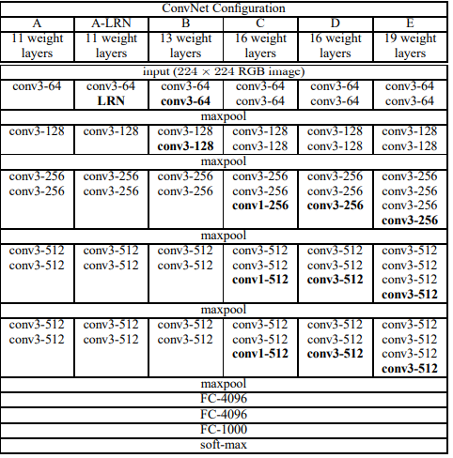
Building New Models
Building off of scratch is too time consuming, so we build off something that already works
Models based on VGG Net architecture
3x3 Kernels, Stride=1
Increasing number of channels after max pool layer

Slide 12
Building New Models
Model 1: 2C → 2FC | Model 2: 3C → 2FC | Model 3: 5C → 2FC | Model 4: 5C → 3FC | Model 5: 6C → 3FC
Input: 6400 | Input: 6400 | Input: 6400 | Input: 6400 | Input: 6400
⇩ | ⇩ | ⇩ | ⇩ | ⇩
6 Conv K=5,S=1,P=0 | 20 Conv K=5,S=1,P=0 | 64 Conv K=3,S=1,P=1 | 64 Conv K=3,S=1,P=1 | 64 Conv K=3,S=1,P=1
⇩ | ⇩ | ⇩ | ⇩ | ⇩
Max Pool K=2,S=2 | Max Pool K=2,S=2 | Max Pool K=2,S=2 | Max Pool K=2,S=2 | 64 Conv K=3,S=1,P=1
⇩ | ⇩ | ⇩ | ⇩ | ⇩
6 Conv K=5,S=1,P=0 | 40 Conv K=5,S=1,P=0 | 128 Conv K=5,S=1,P=0 | 128 Conv K=5,S=1,P=0 | Max Pool K=2,S=2
⇩ | ⇩ | ⇩ | ⇩ | ⇩
Max Pool K=2,S=2 | Max Pool K=2,S=2 | 128 Conv K=5,S=1,P=0 | 128 Conv K=5,S=1,P=0 | 128 Conv K=5,S=1,P=0
⇩ | ⇩ | ⇩ | ⇩ | ⇩
FC 400 | 60 Conv K=3,S=1,P=1 | Max Pool K=2,S=2 | Max Pool K=2,S=2 | 128 Conv K=5,S=1,P=0
⇩ | ⇩ | ⇩ | ⇩ | ⇩
FC 200 | Max Pool K=2,S=2 | 256 Conv K=5,S=1,P=0 | 256 Conv K=5,S=1,P=0 | Max Pool K=2,S=2
⇩ | ⇩ | ⇩ | ⇩ | ⇩
Output: 121 | FC 400 | 256 Conv K=5,S=1,P=0 | 256 Conv K=5,S=1,P=0 | 256 Conv K=5,S=1,P=0
 | ⇩ | ⇩ | ⇩ | ⇩
 | FC 200 | Max Pool K=2,S=2 | Max Pool K=2,S=2 | 256 Conv K=5,S=1,P=0
 | ⇩ | ⇩ | ⇩ | ⇩
 | Output: 121 | FC 400 | FC 2000 | Max Pool K=2,S=2
 |  | ⇩ | ⇩ | ⇩
 |  | FC 200 | FC 1000 | FC 2000
 |  | ⇩ | ⇩ | ⇩
 |  | Output: 121 | FC 400 | FC 1000
 |  |  | ⇩ | ⇩
 |  |  | Output: 121 | FC 400
 |  |  |  | ⇩
 |  |  |  | Output: 121

Slide 13
Results

Slide 14
Results
Model | Training Loss | Training Accuracy | Validation Loss | Validation Accuracy
Model 1 (2C + 2FC) | 1.055 | 0.665 | 1.300 | 0.665
Model 2 (3C + 2FC) | 0.779 | 0.740 | 1.064 | 0.693
Model 3 (4C + 2FC) | 0.625 | 0.787 | 0.987 | 0.712
Model 4 (5C + 3FC) | 0.464 | 0.836 | 0.972 | 0.715
Model 5 (6C + 3FC) | 0.332 | 0.841 | 0.995 | 0.726
Shallow models (1&2) underfit the data, not enough modelling power to capture image details
Adding layers improves metrics, but very marginally
Model 3 has minimum log loss, but model 5 has the best accuracy.

Slide 15
Trying different optimizers
Adam and Adagrad Optimizers fall into the family of adaptive learning optimizers where a different learning rate is set for each individual parameter based on past gradients.
Nesterov variation of momentum, a variant of SGD with momentum that calculates gradients based on approximate future parameters

Slide 16
Results

Slide 17
Remarks
For our problem, the Nesterov implementation performs about the same as the regular SGD w/ momentum
Adam and Adagrad perform a lot worse than SGD
Literature by Wilson Et. Al, and Shirish, N. show this lack of generalization from adaptive learning optimizers.
Hypothesize that our VGG-like model has been tuned for the SGD optimizer

Slide 18
Future Work
Deeper models!
More regularization techniques like L1/L2 and dropout
More transformations like shearing
Ensemble Models
References:
Keskar, N., et al. On Large-Batch Training for Deep Learning: Generalization Gap and Sharp Minima. arXiv preprint. page arXiv:1609.04836, 2016.
Wilson, A. et al. The Marginal Value of Adaptive Gradient Methods in Machine Learning. arXiv preprint. arXiv:1705.08292, 2017.

